Slide 1
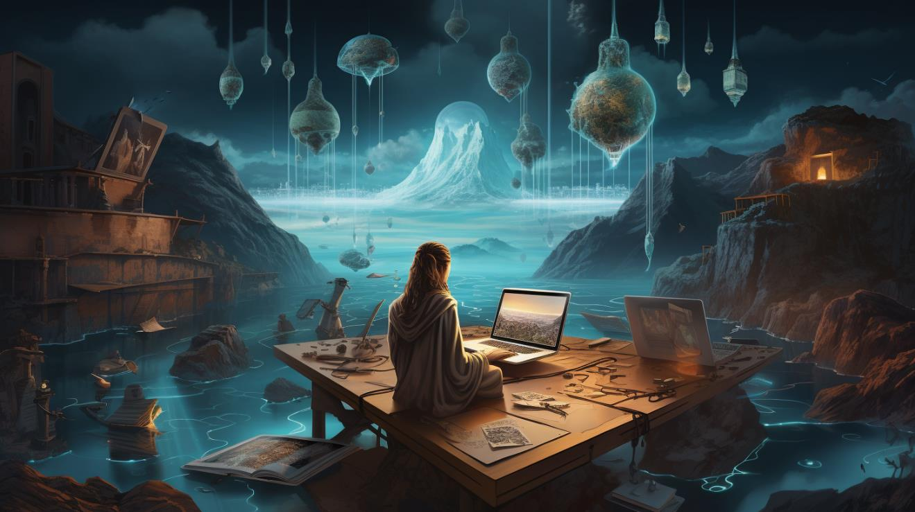
Copyright in the Age of Generative AI
Gergely Csősz
Copyright Department
Hungarian Intellectual Property Office

Slide 2
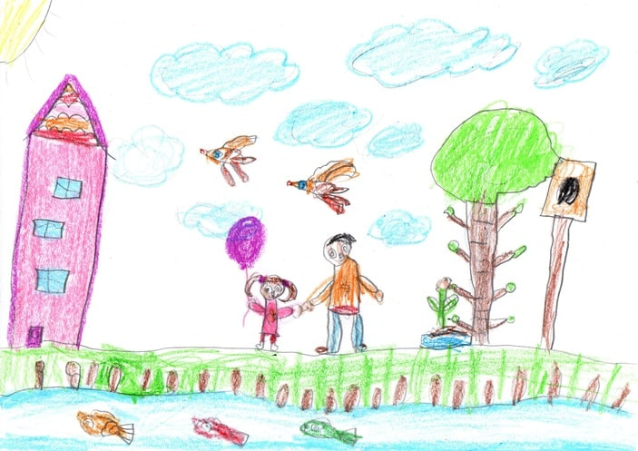

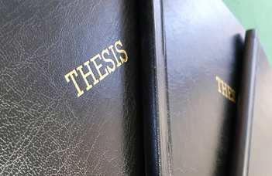
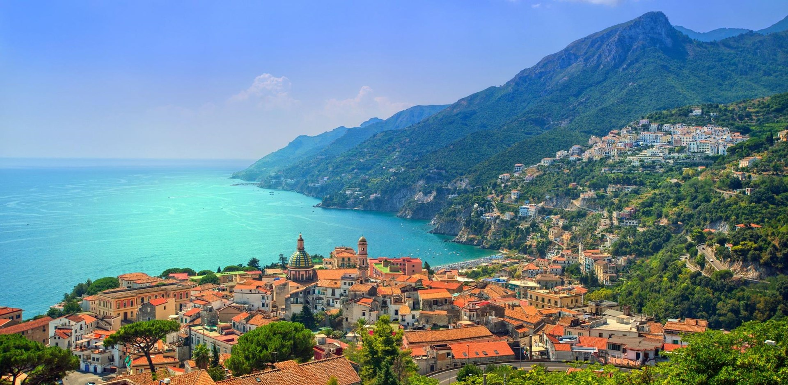
Dr. Csősz Gergely
Have we ever made…
Notes:
Have we ever made… ?
A crayon art?
A Thesis?
Or a photo on a summer holiday?
If the answer is yes: we hold copyright! Legaly, we are authors!

Slide 3
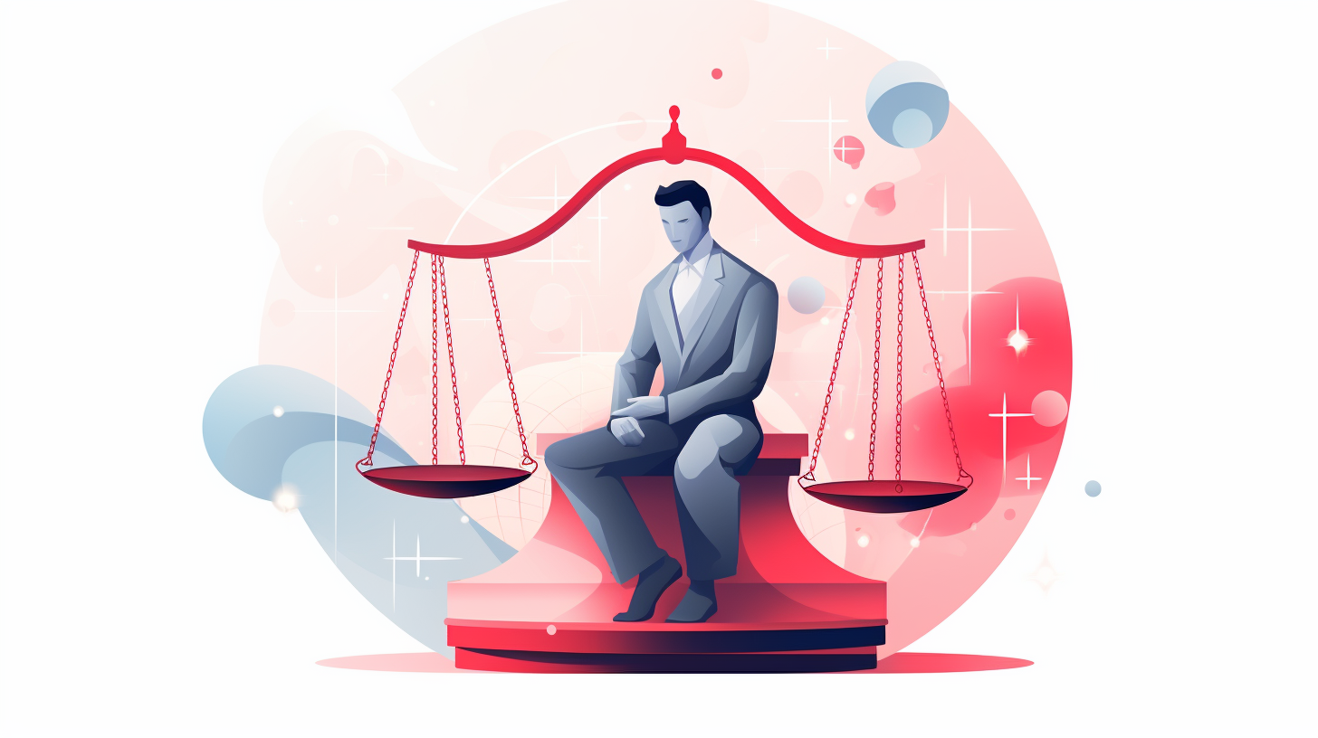

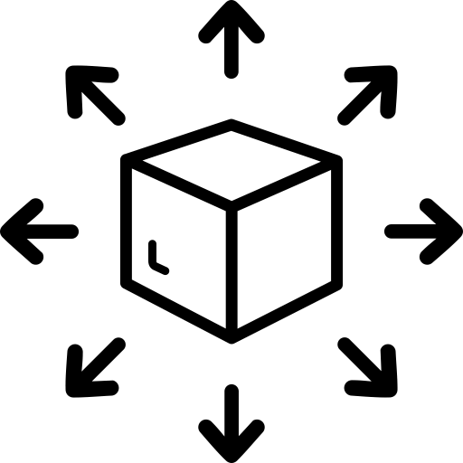
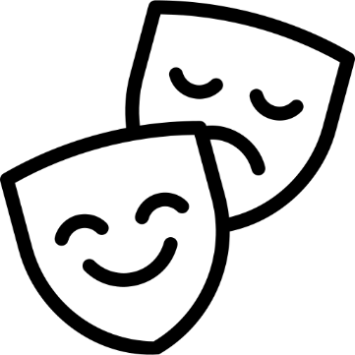



Notes:
What does it mean to be an author (legally)?
We need to be atributed as such regarding our works of art. And if someone wishes to copy, distribute, perform, or share our work online, they need our authroization.

Slide 4


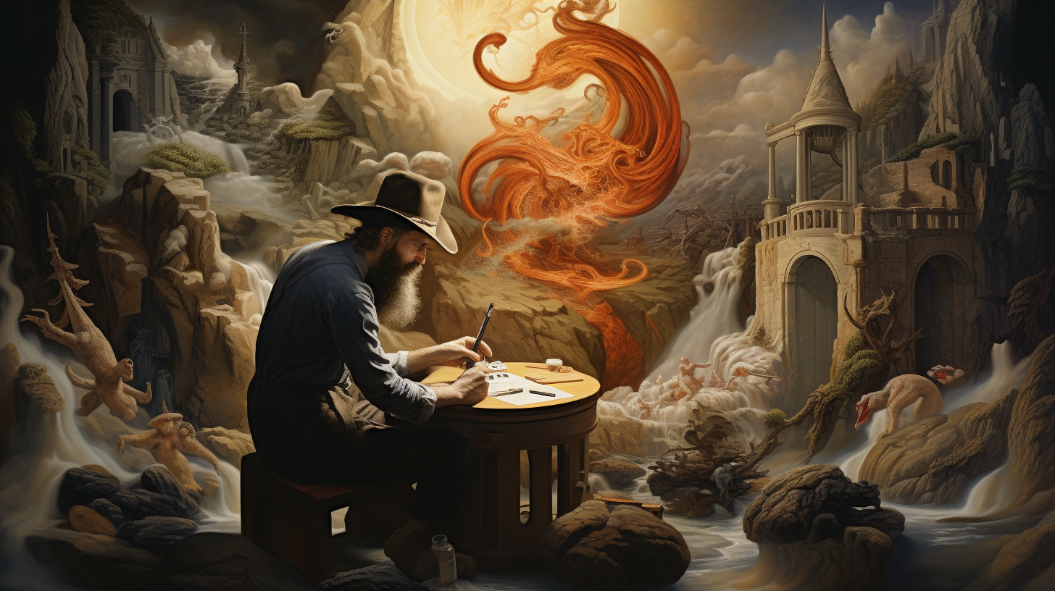


Notes:
What is needed to get Copyright protection? It doesn’t work like patent or trademark, or even design, for copyright we don’t neet to register it.
We only need to create, to express our creativity.
This means that our work need to be more than an idea, we need to give it a form.

Slide 5

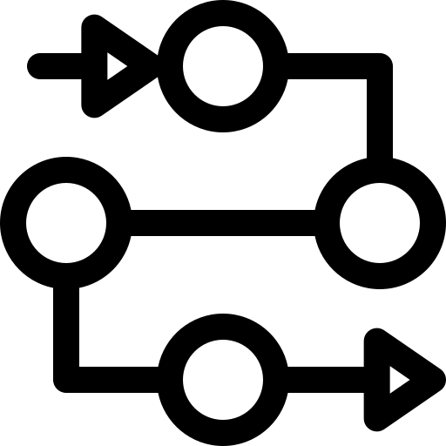
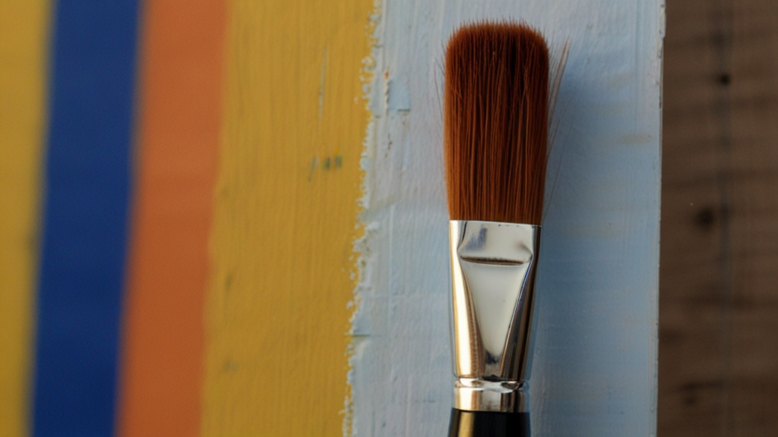
Notes:
Copyright does not protect the idea, the process, or facts.
It protects the creative expression, the stroke of the brush.

Slide 6
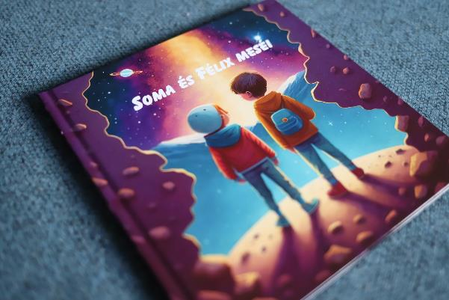
AI and authorship? I.
"...a mother on maternity leave used ChatGPT and Midjourney to create 12 one-minute stories with illustrations in about 8 hours"
Notes:
I hope none of these are news for you. But, given all these basic rules, the question arises around products that were created with AI. Are these things Copyright protected? Should they be?

Slide 7
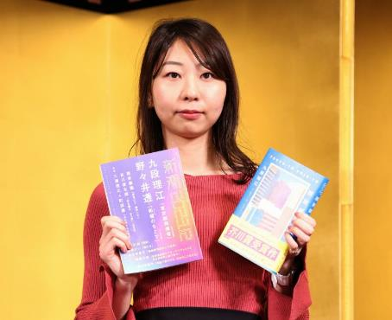
AI and authorship? II.
After Japanese author Rie Kudan won one of the country’s most prestigious literary awards, she admitted she’d had help from an unusual source — ChatGPT.
The author then confirmed at a press conference that around 5% of her book “The Tokyo Tower of Sympathy” — which was lauded by committee members as “practically flawless” — was word-for-word generated by AI.
https://edition.cnn.com/2024/01/19/style/rie-kudan-akutagawa-prize-chatgpt/index.html
Notes:
What about AI assisted works, where the volume of AI production used is marginal, yet the AI served more as a creative coach or assistant? Do these kind of works deserve Copyright?

Slide 8
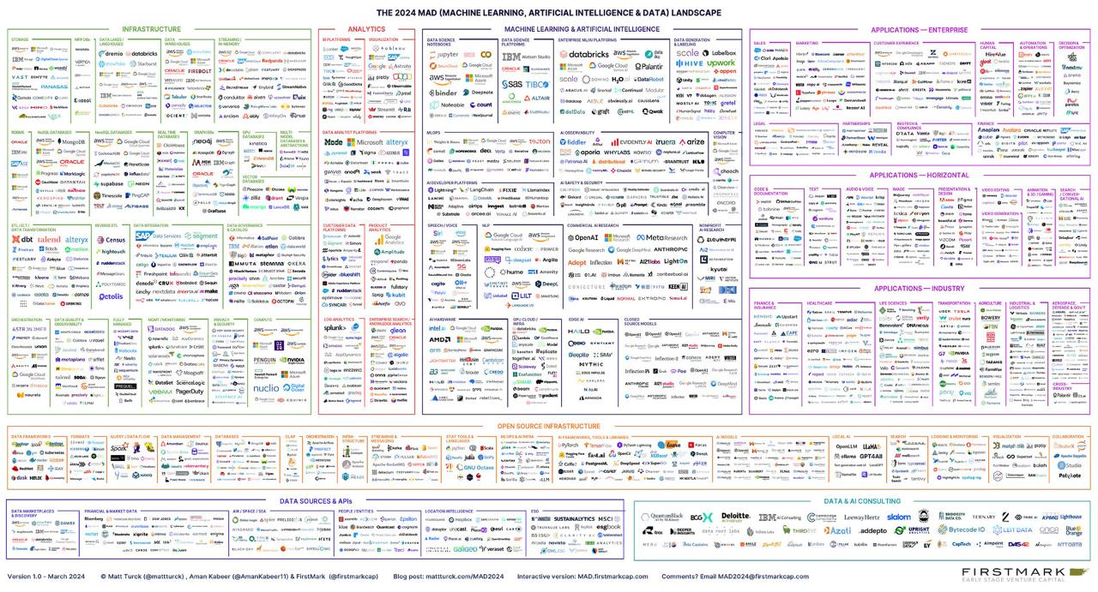
Generatív AI és a szerzői jog
Notes:
And to be honest, this is just the tip of the iceberg. Such industrail and market explosion does not come from a fluke, this is not another „NFT” situation. And we have barely began to explore the full potential of this phenomenon.

Slide 9
AI and Copyright
Input
Output
Notes:
The Copyright discussion around the pehomenon of Generative AI can be sorted into the emerging issues concenrning the AI’s „Input” – the training of AI systems - , and the legal assessment of the generated „Output”

Slide 10
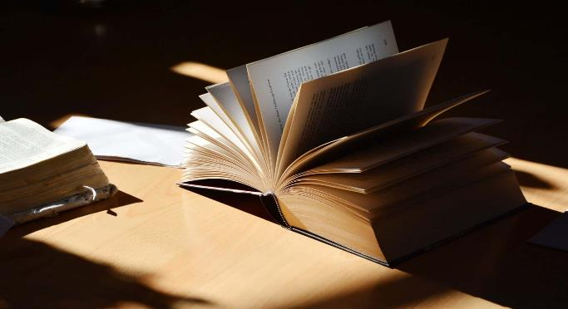
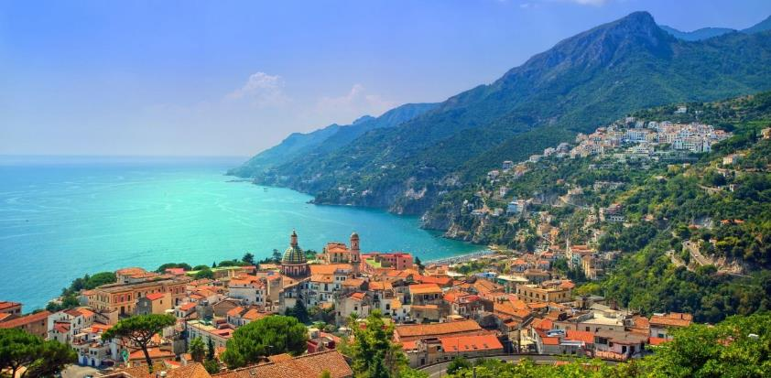

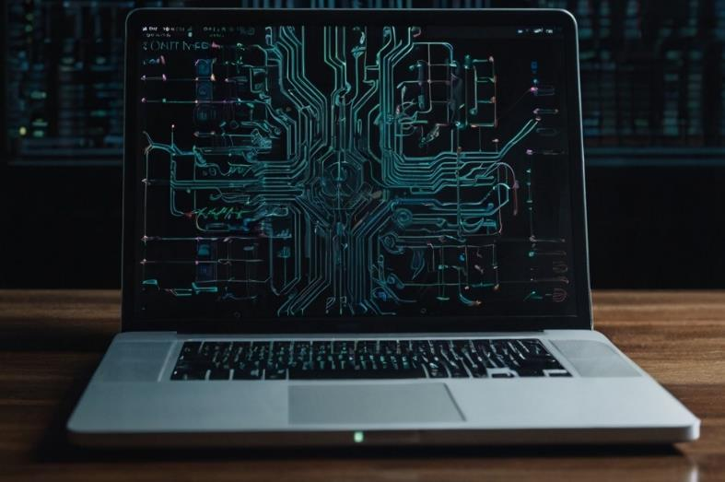
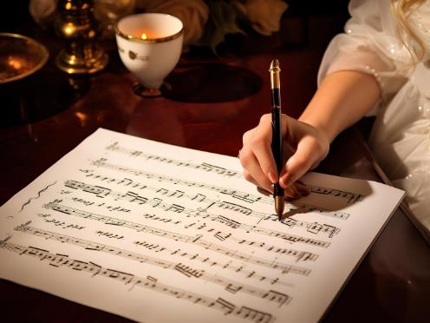

Copyright can protect
Literary works
Photography
News article
Software
Music
Film
Etc.
Notes:
As hinted before, the list of copyright protected works is broad – pretty much open ended. Just to name the usual suspects:
Literary works, photographs, news articles, software, music, film, etc.

Slide 11
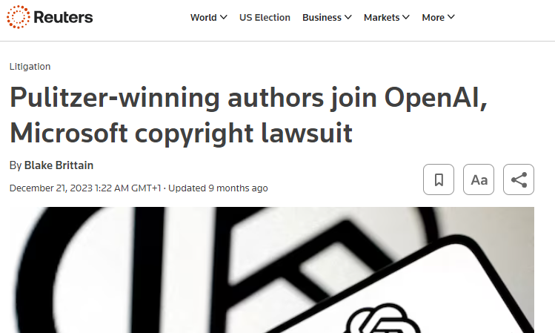
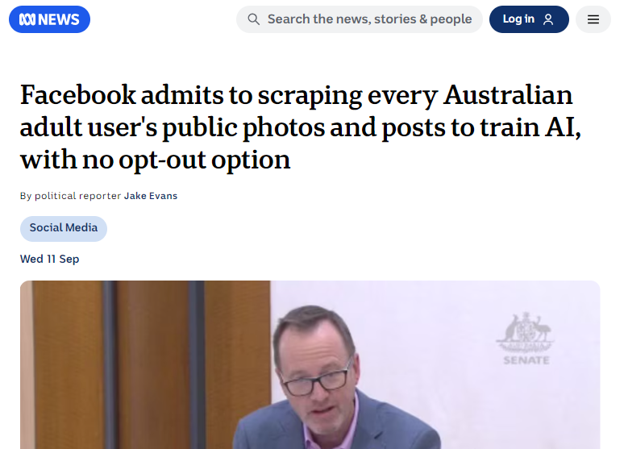
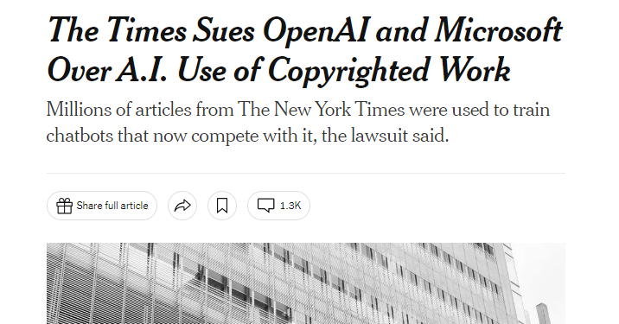

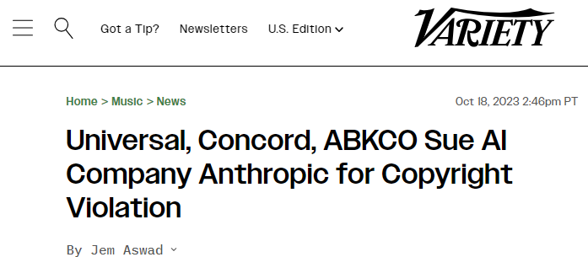
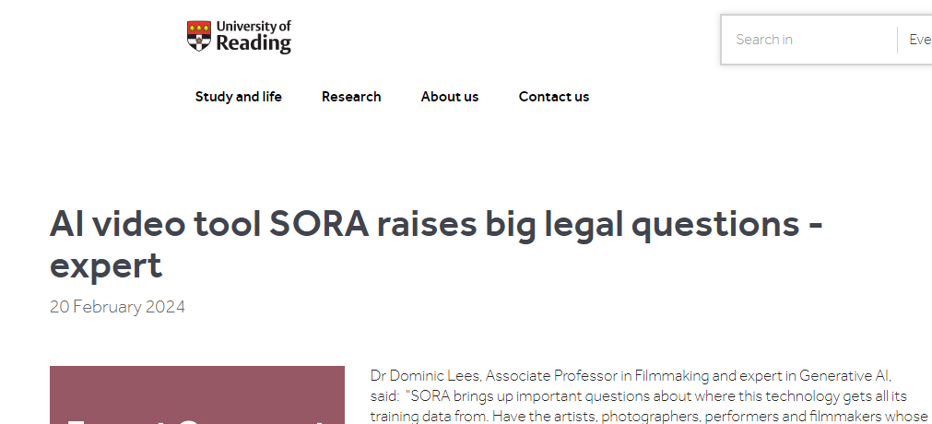
To train an AI we need vast amount of data
In the digital space, „data” can be:
Literary works
Photography
News article
Software
Music
Film
Etc.
Notes:
When we are talking about AI, we usually mean the latest iteration of the Deep Learning Neural Networks, a software designed to mimic human skills. In order to train such models, they need a vast amount of data orignating from humans. Such data in the digital sphere can be:
Literary works, photographs, news articles, software, music, film, etc.
I think from this perspective the problem around training is self evident.

Slide 12
Text and Data Mining (EU)
Exception: no authorisation needed for the defined use
(examples: quotation, private copy)
TDM:
Reproductions and extractions of lawfully accessible works and other subject matter for the purposes of text and data mining.
Rightholders can Opt-Out (machine readable)
Rightholders can’t Opt-Out from TDM carried out for the purposes scientific research.
Notes:
Of course there are exceptions for the Rights granted by Copyright, for example there are legally defined uses that can be carried out with a protected, work without the authorisation of the rightholder. Such are for exaple quotation, private copy, or the Text And Data Mining Exception, defined in the EU with the aim to balance Rightholder’s rights with the support of innovation.
According to the later exception, reproduction and extraction of works can be carried out for the purpose of TDM without authorisation. If the use has a financial aim then the Righolders can Opt-out their works from this use, with a machine readable solution. This seems to be a practical, simple, almost elegant piece of legislation, but the questions are many for the pratical application of this specific rule: who, where and how can and should make the Opt-Out so it would become legally binding? The questions are known to the legislators, and they are working on the details.
If the TDM is carried out for the purpose of research, then the Rightholders don’t even have this option. Again there are some practical question about this rule, like how should we assess when an AI research turns into a commercial endevour? Yet gain, the details need some more work.

Slide 13
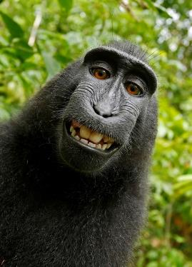
Can AI be an author?
Naruto v. Slater
„Naruto, along with all animals since they were not human, lacked statutory standing under the Copyright Act.”
Thaler v. Perlmutter
„…this case presents only the question of whether a work generated autonomously by a computer system is eligible for copyright. In the absence of any human involvement in the creation of the work, the clear and straightforward answer is the one given by the Register: No.”
Notes:
On the question of the protectability of AI generated content, we also have some prior framework to lean on.
Similar question have risen around copyright concerning selfies created by a monkey (Naruto) with a nature photographers lost camara. The court soberly cut the discussion short, citing that only human can be a holder of copyright - and no, it is not the prhotorapher’s picture just because his camera was used.
Lately they reached a similar decision about AI authorship.
So, AI can’t be an author. We are done, aren’t we, the issue is settled?
A few years ago naively i would have said this. Now… it is a different story.

Slide 14
Output I. – AI product
Delegating the creative effort to the AI
AI can’t be considered author
Nem keletkezik szerzői jog
In different legal systems it might be:
UK model – „computer generated work”
Rightholder is the person „by whom the arrangements necessary for the creation of the work are undertaken”
New Ukrainian Copyright Act – sui generis protection
Notes:
Certanly, if we delegate the creative decision making and expression process to an AI, that can’t be considered an author, there should be no Copyright. At least, not without specific regulation covering similar cases. In some contries, like the UK, there is a disctinct cathegory for computer generated works that were created without human intervention. There is a similar model in the latest Ukrainian Copyright Act also, that was specifically written with AI in mind. Is this a beginning of a trend?
So far it doesn’t seem so, but it is not implauseble. Copyright is about the protection human creation, but around it have risen a few other, so called „neighbouring rights” in the last decades that are concerned more with the protection of investment into the creative process. Such are the phonogram- or film producer’s neighbouring rights. Personally I’m not a fan of the idea to provide such protection to a purely AI generated contents, but it is not unheard of either.

Slide 15
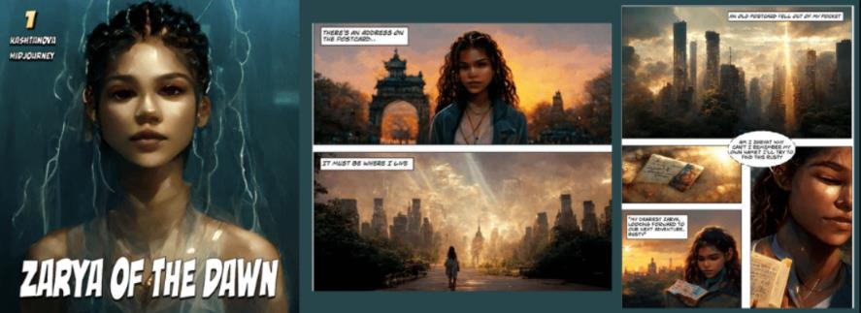
Output II. – Human creation
Human work on an AI creation might be Copyright protected
If it deemed by it’s own merit
Notes:
But what if we put some honest human sweat and tears into a worksflow that happens to use an AI or AI product?
In one case in the US a comic was created whit the use of AI generated pictures, but a human edited it to a consistent story and a human author wrote the dialogues and narration. By these later aspects the work was deemed partially Copyrightable – the human created part at least.
In another case a graphical designer used an AI generated image and put a lot of work into it’s details, yet it wasn’t deemed protectable for not contributing any new, original element to the pricure.
This is of course the US practice so far, but from this it seems they think that Copyright is only applicable, if the human involvment could be considered protected by it’s own merit.

Slide 16
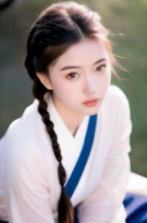

Can an AI be considered as a creative tool?
U.S. Copyright Office – Allan case
~600 prompt
„[W]hen an AI technology receives solely a prompt from a human and produces complex written, visual, or musical works in response, the ‘traditional elements of authorship’ are determined and executed by the technology—not the human user.”
Beijing Internet Court – Li v. Liu
~150 prompt
„[T]he human author keeps experimenting and adding various prompts, negative prompts and tech parameters until he receives the final satisfactory piece.”
Notes:
But what if we view the AI as a creative tool, like a digital camera? Well, there are legal decisions about this question, thankfully. They come from two, disctinctly different legal systems outside of Europe, and of course they seemingly totally contradict each other.
In the Allen case the US Copyright Office highlighted the fact that the AI have to interpret the user’s prompt, and this interpretation serves as a guide for it’s generating process. They considered this as a restriction on the human contribution, so much so that they deemed it negligable. And we alredy talked about the relationship between copyright and purely ai generated content…
Contrary to this, the Beijing Internet Court suggested that an experimentative process using iterative chain of prompts and parameters can be considered as human creative contribution in the process, and such process can generate a Copyrightable work.
I think both of these decision can be considered sound in their relevant cases (altough the Beijing court was criticized for leaving out some relevant aspects), and both raise some point that should be considered for future reference, but I also think neither could be considered as a final say in the question. In the context of Copyright protection a creative process or tool have to be assessed by the creative controll it provides for the author. There is undeniably a wide array of option trough we could manipulate an AI generation: choice of model, version, complexity of prompt, parameters, workflow, and so on. The issue we must be aware of is that if we don’t make eligable choice, or don’t make a choice, the AI could make them for us.

Slide 17

Human contribution
Autonomous AI creation
Creation without AI
Notes:
So where does this all leave us with the AI generation? It is clear that the amount of human involvement is the key of the assessment. But how much is enough? How should it be expressed? How can we mesure creative human decision making in the creation process? We have a lot of work ahead us before we come up with simple answers.

Slide 18
Thank you! gergely.csosz@hipo.gov.hu szjftitkarsag@hipo.gov.hu

