Slide 1
Black Box or Glass Box?
Transparency Challenges Concerning Generative AI Systems
Regulatory and Ethical Implications of Generative AI panel
Dr. Anna Zsófia Horváth LL.M. (Göttingen),
Associate, CMS CEE

Slide 2

Introduction to generative AI

Slide 3

Projected value of the generative AI ecosystem

Slide 4
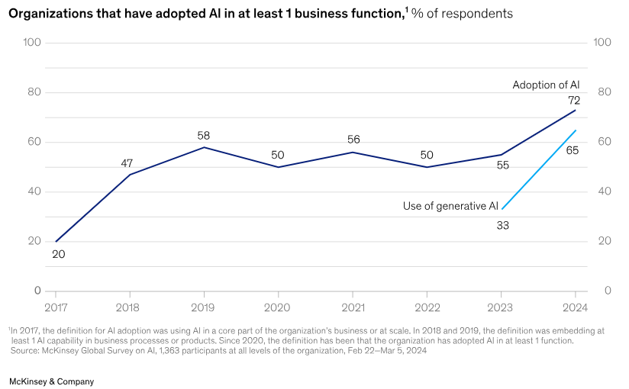
Adoption of generative AI systems worldwide
Notes:
In 2023, the world discovered generative AI (gen AI),
and by 2024, organizations started using it to create real business value.
According to McKinsey's latest AI survey, 65% of respondents say their organizations regularly use gen AI—almost double the figure from ten months ago. Expectations remain high, with three-quarters predicting gen AI will bring significant or disruptive changes to their industries in the coming years.

Slide 5

Large generative AI models are a typical example for a general-purpose AI model, given that they allow for flexible generation of content, such as in the form of text, audio, images or video, that can readily accommodate a wide range of distinctive tasks.
EU AI Act, Recital (99)
General-purpose AI models, in particular large generative AI models, capable of generating text, images, and other content
EU AI Act, Recital (105)

Slide 6
The Transparency Dilemma

Slide 7
The Black box metaphor
Black box AI systems
Glass box AI systems
What is it that we don’t know?
Intent
Causation*
operate based on internal processes that are invisible to the user,
„inability to fully understand an AI’s decision-making process and the inability to predict the AI’s decisions or outputs”*
transparent and interpretable, allowing users to understand and trace how the AI system makes decisions
*Bathaee, The AI Black Box and the Failure of Intent and Causation, Harvard Journal of Law & Technology, Vol. 31, 2018
Notes:
Within policy and legal debates, AI systems are often described as black boxes. This metaphor frames an AI system as an object not amenable to scrutiny of its inner workings,
an opacity that stems from technical factors such as the vast amount of data it processes and its technical complexity.
This obscurity raises critical questions about trust and ethics.
To be sure, we may be able to tell what the AI’s overarching goal was, but black-box AI may do things in ways the creators of the AI may not understand or be able to predict.
Black Box: A system whose internal workings are not visible or understandable to users.
One possible reason AI may be a black box to humans is that it relies on machine-learning algorithms that internalize data in ways that are not easily audited or understood by humans.
Glass Box: A system with transparent, understandable processes that allow users to understand how decisions are made.
This opacity raises significant challenges in legal, ethical, and regulatory contexts.
Intent: AI or the developer? – software malfuncion v. delierate harm to competitors example. / fault based liability systems
Causation: Doctrines such as proximate cause ensure that only reasonably foreseeable effects give rise to liability.134 Such a doctrine encourages individuals to act re

Slide 8
Explanations for the lack of transparency
Model Complexity
Intricate architectures with thousands of parameters, creating a barrier to human interpretation.
Non-Linear Decision Pathways
Outputs are the result of numerous interconnected layers and iterative learning processes,
Opacity of Training Data
Training datasets may be too large, obscuring the sources of bias, error, or other influential factors
Proprietary Constraints
Lack of disclosure limiting external scrutiny
Notes:
Possible explanations for the black box effect include:
Model Complexity
Advanced AI systems, particularly those employing deep neural networks, involve intricate architectures with thousands or millions of parameters. These models operate through highly abstract mathematical computations that defy intuitive understanding, creating a barrier to human interpretation.
Non-Linear Decision Pathways
Many AI models, especially those utilizing machine learning, rely on non-linear processing of data. Outputs are the result of numerous interconnected layers and iterative learning processes, making it difficult to trace or explain the causal relationship between input data and the resulting decisions.
Opacity of Training Data
The black box effect is often compounded by insufficient transparency regarding the data used to train the AI system. Training datasets may be too large or proprietary, obscuring the sources of bias, errors, or other influential factors embedded within the system.
4. Proprietary Constraints
Developers of commercial AI systems often guard their algorithms as trade secrets. This lack of disclosure limits external scrutiny and contributes to the black box effect, particularly in high-stakes contexts such as finance, healthcare, and law enforcement.
************
First, a lack of transparency may arise from the complexity of the algorithm’s structure, such as with a deep neural network, which consists of thousands of artificial neurons working together in a diffuse way to solve a problem. This reason for AI being a black box is referred to as “complexity.”
Second, the lack of transparency may arise because the AI is using a machine-learning algorithm that relies on geometric relationships that humans cannot visualize, such as with support vector machines.

Slide 9

Challenges of Achieving Transparency
Technical challenges
Visibility of the mechanisms that produce the computational results produced by an AI system
Legal challenges
Definitions of what is disclosed, when it is disclosed and to whom the disclosure is addressed
Specific or high-level requirements, aspects and set of criteria necessary to disclose
Paradox: An AI system's internal structure can render it opaque, but technical interventions alone are unlikely to eliminate this opacity.
Enforcement, proprietary information
Notes:
The issue from the policy side is the difference between legal and technical understandings of transparency. While both lawyers and scientists invoke concepts such as “transparency” and “explanation”, they often ascribe different meanings to the term.
Paradox: An AI system's internal structure can render it opaque, but technical interventions alone are unlikely to eliminate this opacity.
visibility of the mechanisms that produce the computational results produced by an AI system

Slide 10
Legal and Ethical Implications
Regulatory Landscape: The push for transparency in AI, particularly in Europe (e.g., EU AI Act), and the global debate on balancing innovation and accountability (XAI, trustworthy AI).
Data Protection: How transparency intersects with privacy and data protection laws, such as GDPR's right to explanation.
„FAT” principles Fairness, Accountability, Transparency: Who is responsible when AI systems make harmful or biased decisions?
Discrimination or bias: Lack of transparency can obscure biased decision-making embedded in AI systems.
Autonomy and Consent: Opacity deprives users of meaningful control over their interactions with AI systems.
Trust and Public Confidence: A lack of transparency erodes public trust in AI systems, particularly when their decisions have significant societal impacts.

Slide 11
Solving the Transparency Problem

Slide 12
Strategies for Enhancing Transparency
Explainability Techniques: Methods such as model-agnostic tools (e.g., LIME, SHAP) that help interpret complex AI models.
Auditing and Oversight: Third-party audits and continuous monitoring to assess AI behaviors and outcomes
Design Principles: Encouraging the development of AI models with built-in transparency, such as more interpretable architectures or user-friendly interfaces
Regulatory requirements: constructive approaches, such as in the EU AI Act, require certain degree of transparency, from specific actors.
Notes:
Post-hoc explanation

Slide 13
Ready-to-go solution of the EU AI Act
EU approach: horizontal transparency requirements for AI systems [EU AI Act Art. 1(2)(d)], accompanied by existing horizontal transparency rules (s. GDPR)
Transparency requirements specific to certain AI systems and actors
Transparency and provision of information to deployers of high-risk AI systems [Art. 13(1)]
  „their operation is sufficiently transparent to enable deployers to interpret a system’s output and use it appropriately”
Transparency obligations for providers and deployers of certain AI systems [Art. 50(1)-(4)]
  „ inform the natural persons concerned that the system is an AI system or that the system output is AI-generated”
  Chatbots, deepfakes, AI-generated content
Notes:
The AI Regulation lists transparency as a key requirement to ensure the ethical and responsible handling of data. Accordingly, AI systems that fall into certain risk levels are subject to requirements regarding an appropriate level of transparency and sufficiently transparent operation of the systems.

Slide 14

Where do we go from here?
Do we…
live with the black box?
change the existing legal framework?
require technological
solutions?
wait, and see?
…to be continued

Slide 15
Thank you!

