Slide 1
Leveraging Open Large Language Models for
Multilingual Policy Topic Classification:
The Babel Machine Approach
Miklós Sebők, Ákos Máté, Orsolya Ring, Viktor Kovács, Richárd Lehoczki
Kovacs.Viktor@tk.hu
2nd Budapest Methods Workshop on Large Language Models and Generative AI:
Social Science Applications and Legal Aspects
Viktor Kovács
Data Scientist, poltextLAB, HUN-REN Centre for Social Sciences

Slide 2
Context
Providing an automated solution to multilingual text classification using LLMs
Comparative political research still mostly relies on expert coding of text (which is expensive and time consuming)
Combining the existing labeled data and large language models should free-up expert resources and concentrate on validation
Our use case: Comparative Agendas Project codebook:
  21 major policy category + ”no policy content”

Slide 3
Context
Dictionary-based and ML approaches: Albaugh et al. 2013
Traditional machine learning using SVM, NB, LR, XGB: Burscher, Vliegenthart, and De Vreese (2015); Karan et al. (2016); Sebők, Kacsuk, and Máté (2022)
Non-english machine learning using SVM, NB, PA: Burscher et al. (2015), Welbers et al. (2017), Loftis and Mortensen (2020), and Sebők and Kacsuk (2021)
Large language models (BERT) and deep learning: Frantzeskakis and Seeberg (2022)
Traditional ML performance (macro F1) on CAP coding is around 0.6-0.7
LLM performance is 0.7-0.9 F1

Slide 4
Objective
Main objective: to develop an alternative to double-blind human coding
  Cost
  Speed
  Reliability
  Validity
A solution instead of pre-trained models or complex algorithms
  Accessible without requiring technical expertise
  Serves as a blueprint for solving other research problems
Fine-tuned models
Inference platform

Slide 5
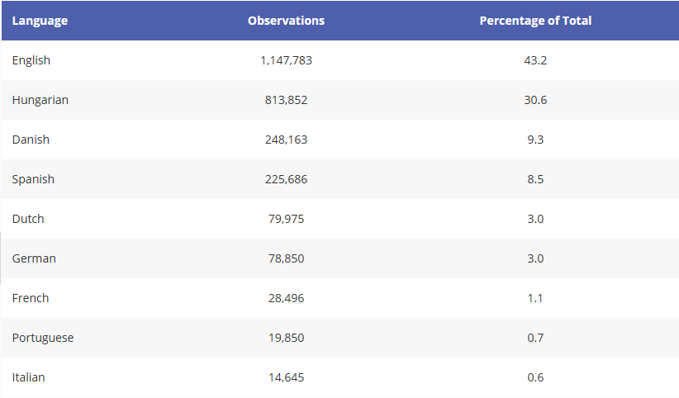
Data
9 languages, 10 domains
Fine-tuning data: 2.5 million observations
  CAP database
  Donated data
Highly imbalanced
  Language
  Domain
  Data source
  Label
Language shares in the fine-tuning data

Slide 6

Data

Slide 7

Data

Slide 8
Methods
Model: XLM-RoBERTa (large)
  Pre-training data: 2.5TB of filtered CommonCrawl
  (100 languages)
  Outperforms multilingual BERT
Multiple fine-tuned models:
  Pooled
  Language-specific
  Language-domain-specific

Slide 9

Methods
No model rules them all…

Slide 10
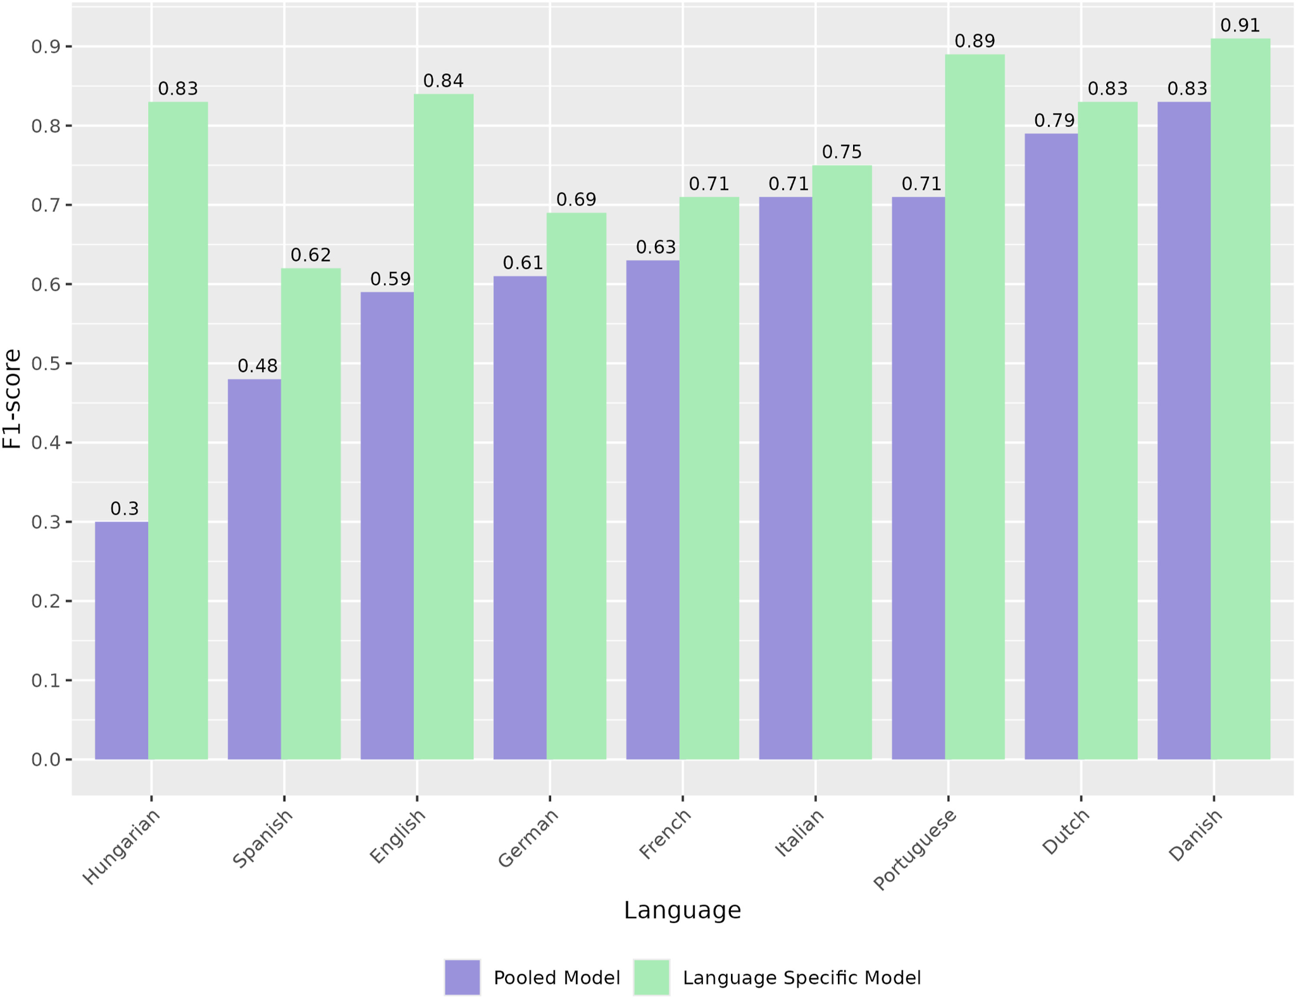
Results
Pooled versus language-specific models (weighted macro F1)

Slide 11
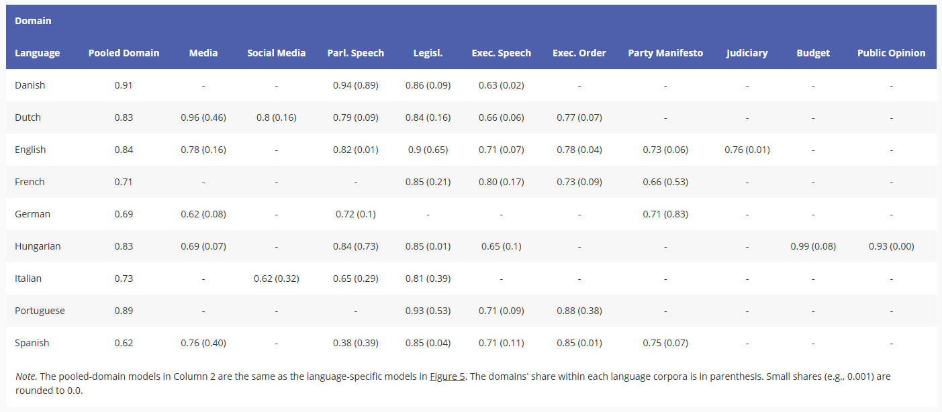
Results
Performance by language-domain pairs (weighted macro F1)

Slide 12
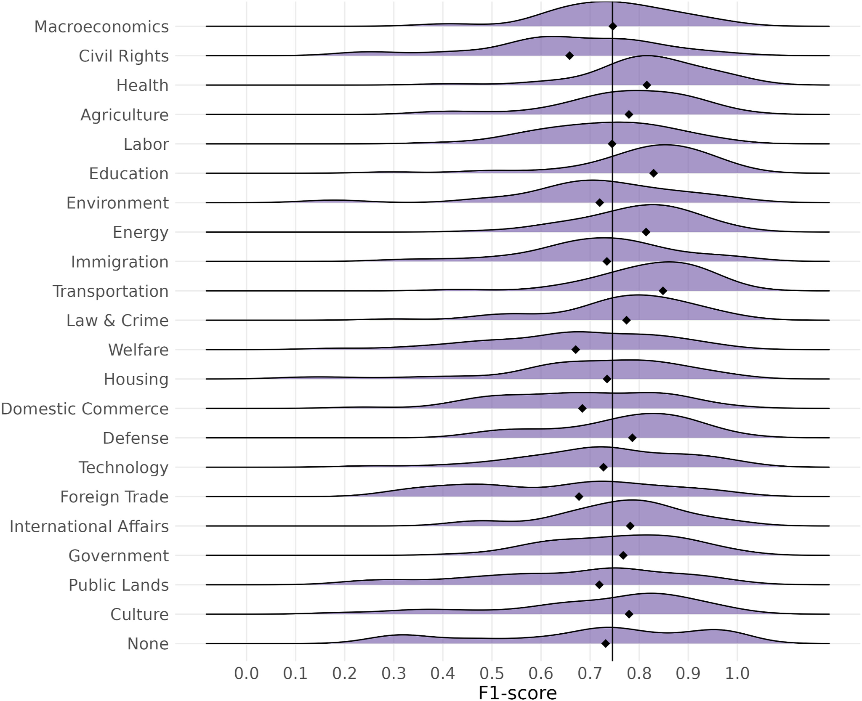
Results
Distribution of micro F1 scores and their medians across CAP topic.

Slide 13
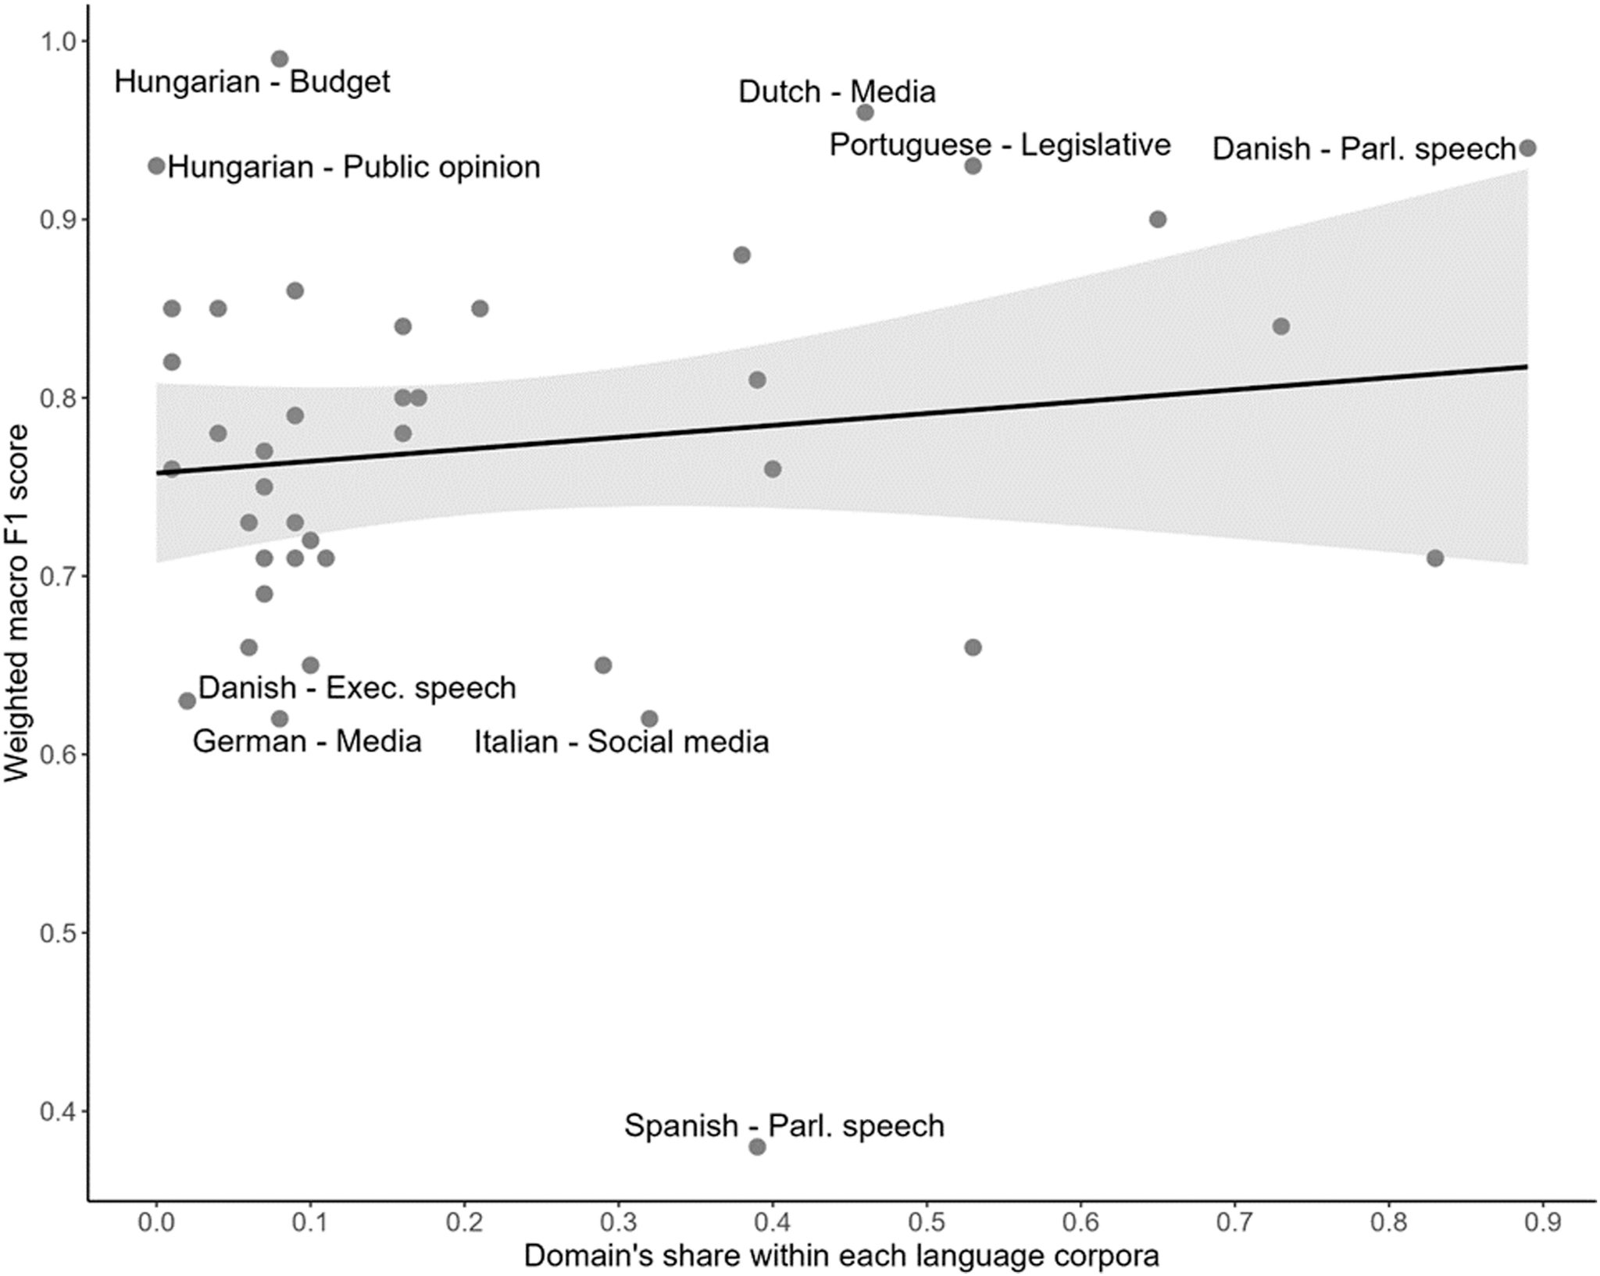
Discussion
Performance is not entirely data driven!

Slide 14
Discussion
Pooled data (across languages and domains) results in poor model performance
Careful partitioning of the data increases model performance drastically
Model performance plateaus regardless of fine-tuning data composition
LLM performance in some cases outperforms human coding
(above 0.85 macro F1)

Slide 15
New tasks
Beyond the paper…

Slide 16
New tasks
Sentiment (3) – Emotions (6) – CAP (21+1) – Manifesto (56+1)
Increasing the number of labels increases task complexity
No Policy Content?
  Still difficult to detect
  Beta test: we have fine-tuned smaller (DistilBERT) models to detect whether the given text has relevant content, and use it in series with the large model that predicts the correct label

Slide 17
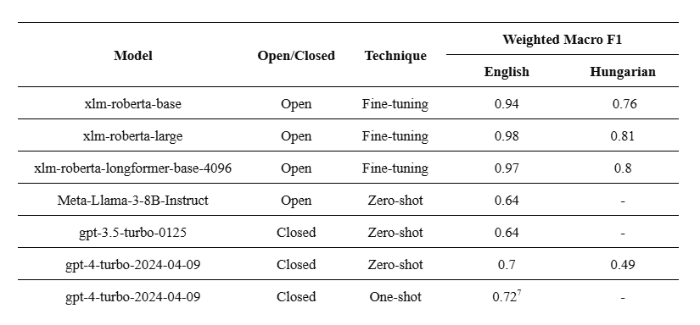
New models
Open generative models
  Preliminary results show no improvement in performance
  More parameters - more resources
  Slower inference
  Reproducibility?
An area still not fully explored
  More efficient prompting
  5-10 shot classification
  Fine-tuning
Weighted macro F1 comparison of BERT-based and generative models
(CAP classification task, evaluated on long documents)

Slide 18








































Final notes
Users of the Babel Machine (as of November, 2024)

Slide 19
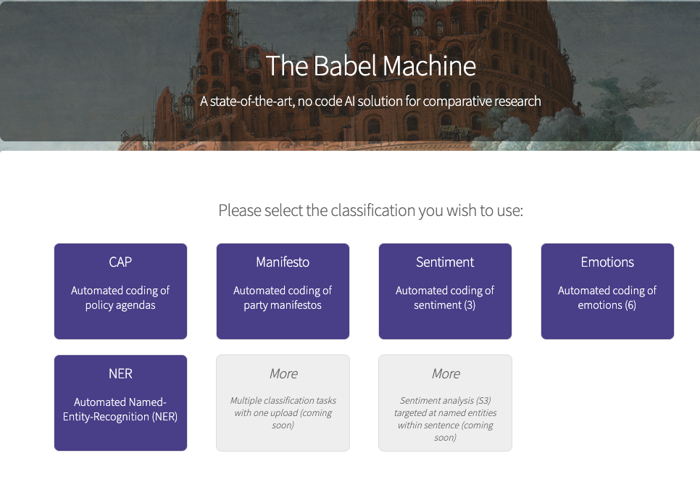
Final notes
Try the Babel Machine at: https://babel.poltextlab.com

Slide 20
Thank You!
Kovacs.Viktor@tk.hu

