Slide 1




The ParlText database of the V-Shift Momentum project
Miklós Sebők, Csaba Molnár, Anna Takács
21st November 2024
2nd Budapest Workshop on LLMs and Generative AI

Slide 2
Need for legislative data and corpora
Rapid emergence of text-as-data approaches and Natural Language Processing methods
New opportunities for quantitative legislative studies
But: relevant and directly usable corpora associated with adequate metadata is crucial
Potential usage:
Revealing the yet hidden patterns and characteristics of political behaviour and governance
Making comparative research design more widespread
Pilot datasets: focus on legislative activities of Central East European region as an underresearched region
Czechia, Hungary
Parliamentary speeches, bills, laws

Slide 3
The most significant precursors of ParlText
Dataset name | N of polities | Coverage of V4 countries | Domains | Maximum timespan
CLARIN | 29 | Czechia, Hungary, Poland | Speech | 2015-2022
CAP | 27 | Hungary | Speech, bill, law, media etc. | 1000-2023
ParlEE | 28 | Czechia, Hungary, Poland, Slovakia | Speech | 2009-2019
ParlSpeech | 9 | Czechia | Speech | 1987-2019
ParlLawSpeech | 8 | Czechia, Hungary | Speech, bill, law | 1993-2022 (until May)

Slide 4
The ParlText database
Corpora + metadata + data linkage
Pilot: Czechia and Hungary
Some metadata:
Speeches: Agenda item, electoral cycle, date of presentation, place within the given session, bill linked to the speech
Bills: Bill title, official registration number of the bill, electoral cycle, date of introduction, law linked to the bill
Laws: Law title, official year and number of the law publishment, electoral cycle, date of publishment, bill linked to the law
Text of the observations

Slide 5
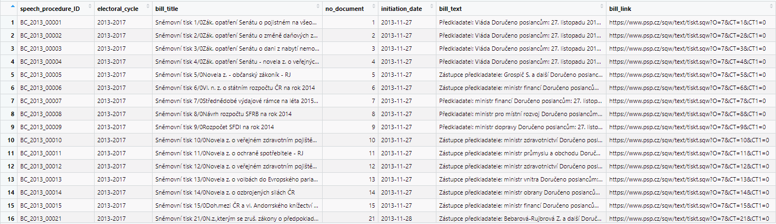
Linkage process
Based on ParlLawSpeech
Introduced bills - Parliamentary speeches discussing them - published laws
Web-scraping parliamentary corpora and datasets
Segmentation difficulties (Czechia, Poland, Slovakia)
Multiple
linking

Slide 6
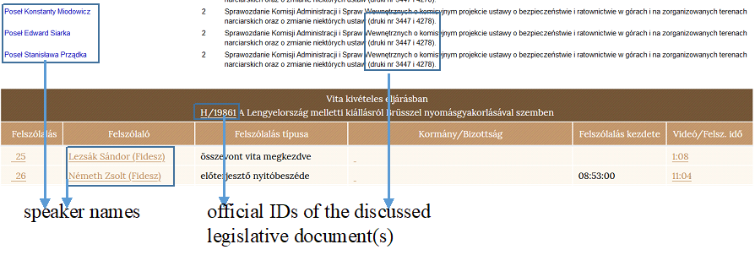
Linking example of Polish and Hungarian speeches to bills

Slide 7
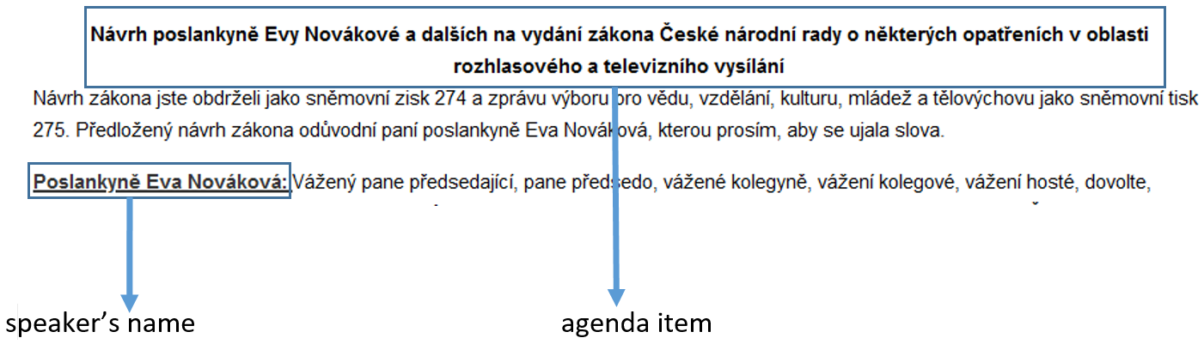
Difficulties regarding agenda extraction of Czech and Slovak parliamentary speeches
In the Czech case, it appears only in some electoral cycles

Slide 8
Descriptive statistics
Country | Data | Count | Time frame
Czechia | Laws | 3,179 | 1990-2023
 | Bills | 12,471 | 1990-2023
 | Speeches | 493,872 | 1990-2023
Hungary | Laws | 4,733 | 1990-2022 (until May)
 | Bills | 8,220 | 1990-2022 (until May)
 | Speeches | 564,655 | 1990-2022 (until May)
Poland (in progress) | Laws | 5,837 | 1991-2024
 | Bills | 9,488 | 1991-2023
 | Speeches | 155,403 | 2015-2022
Slovakia (in progress) | Laws | 4,363 | 1990-2024
 | Bills | 13,056 | 1990-2023
 | Speeches | NA | NA

Slide 9
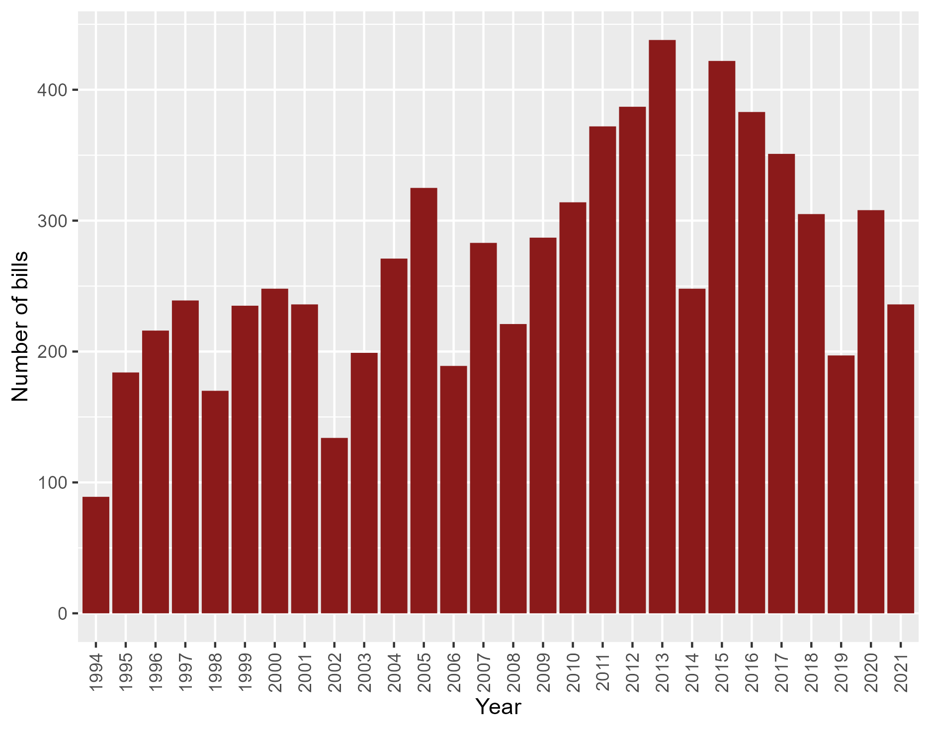
Data validation: amount of Hungarian bills by year

Slide 10
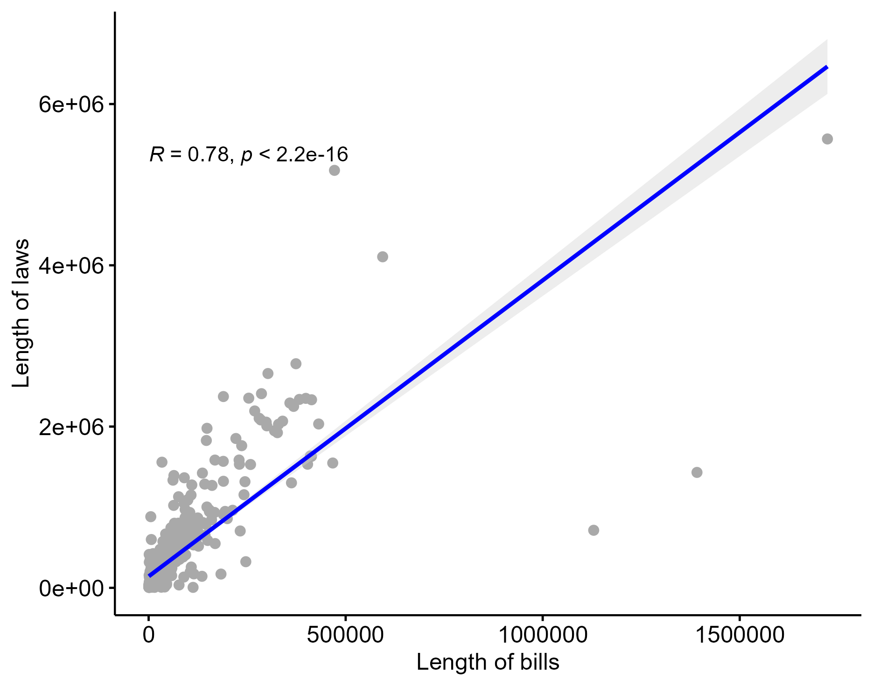
Data validation: correlation between length of Czech bills and laws

Slide 11
Further goals and potential usages
Including recent data
Expanding the database to other countries and regions
New research on legislative processes, trends, and patterns of legislative activity
E.g. polarisation, discourse analysis, policy frames, issue ownership etc.
Wider geographical horizon, wider time frame, new metadata
Interactions among different arenas of politics

Slide 12
Thank you for your attention!
COMING SOON:
https://parltext.org/

