Slide 1
Regulating General Purpose AI
A Comparative Analysis of Regulatory Models in the UK, the EU, the USA, and Australia
M. Varju

Slide 2
The regulatory dilemma
The risks of GPAI/foundation models have been flagged up, but their regulation is affected by dilemmas concerning
Timing
Proportionality
Ideology (paternalism, liberal paternalism, free enterprise etc)
Structure (centralised vs decentralised)
Experimentation vs precaution (access to the technology)
Prescriptive vs cooperative
Adaptability vs certainty
Use cases vs outcomes
Regulatory competition
RDI ecosystem and industrial policy

Slide 3
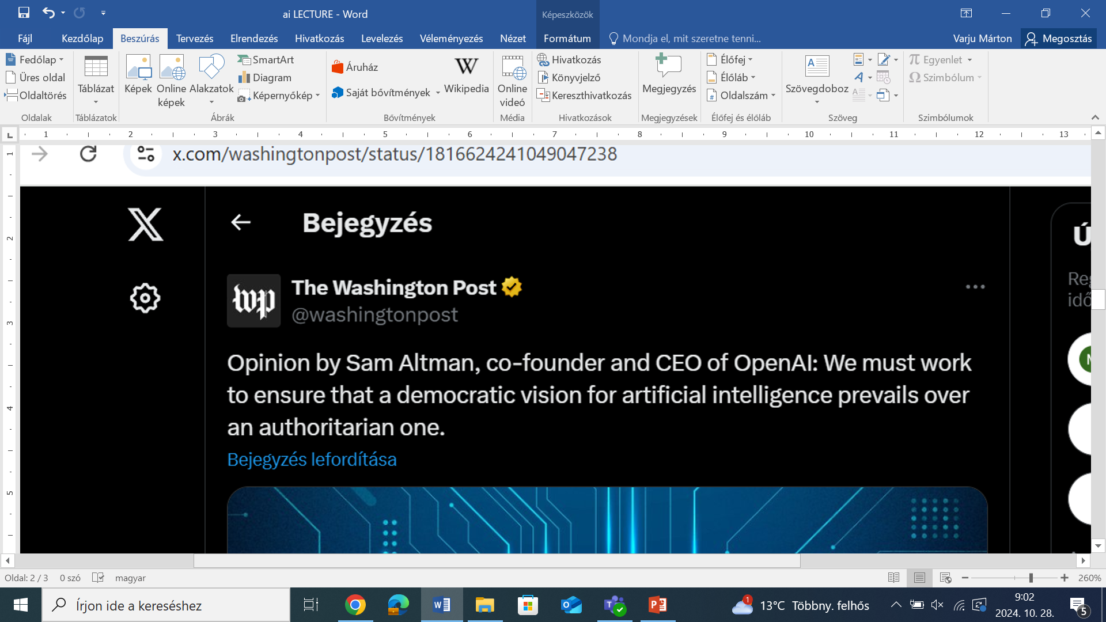
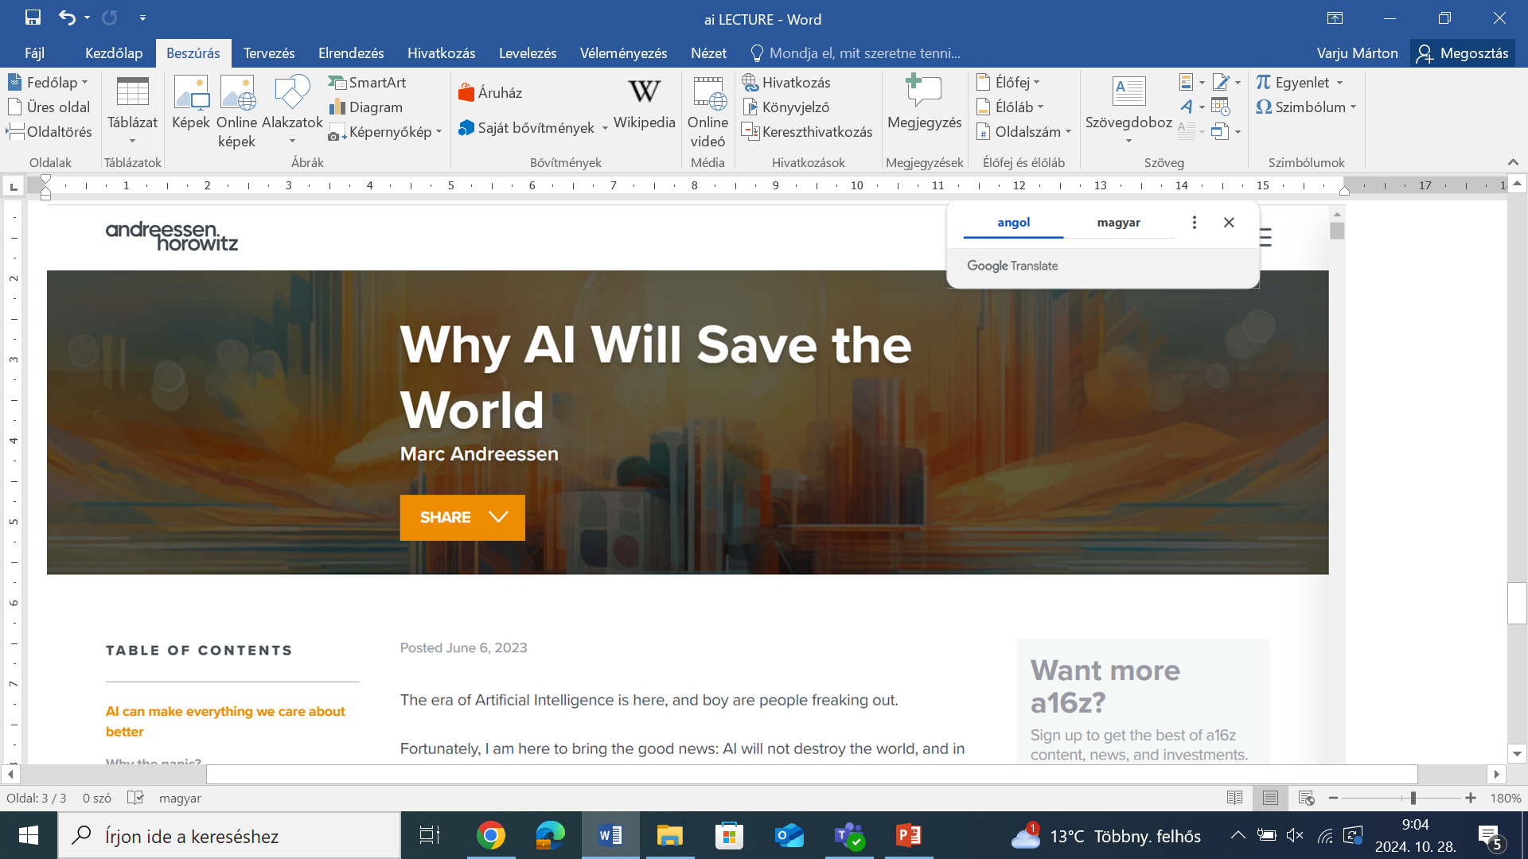
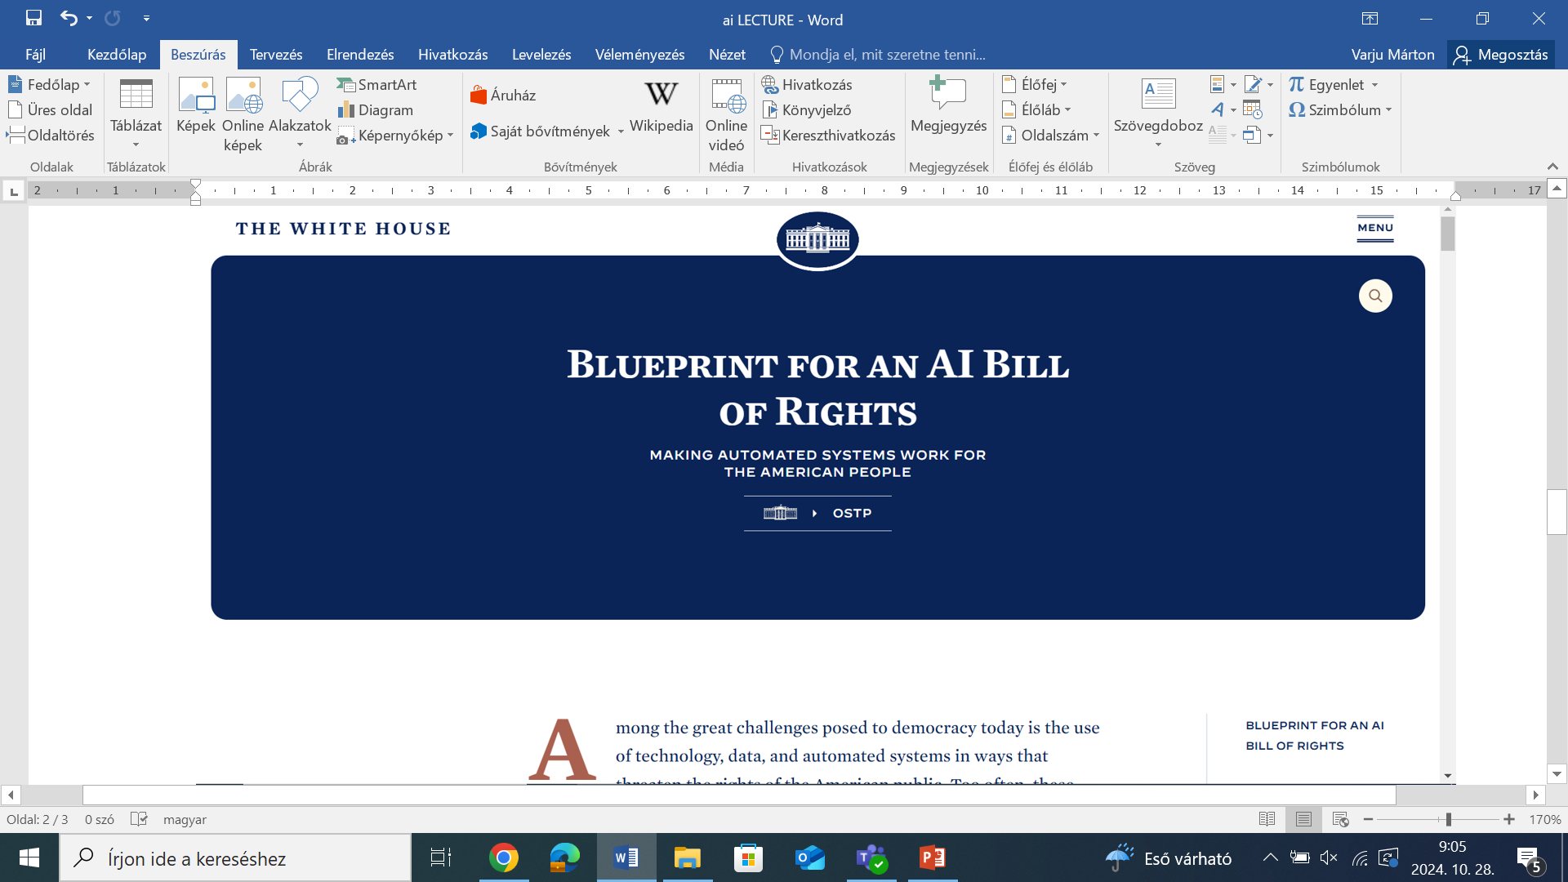
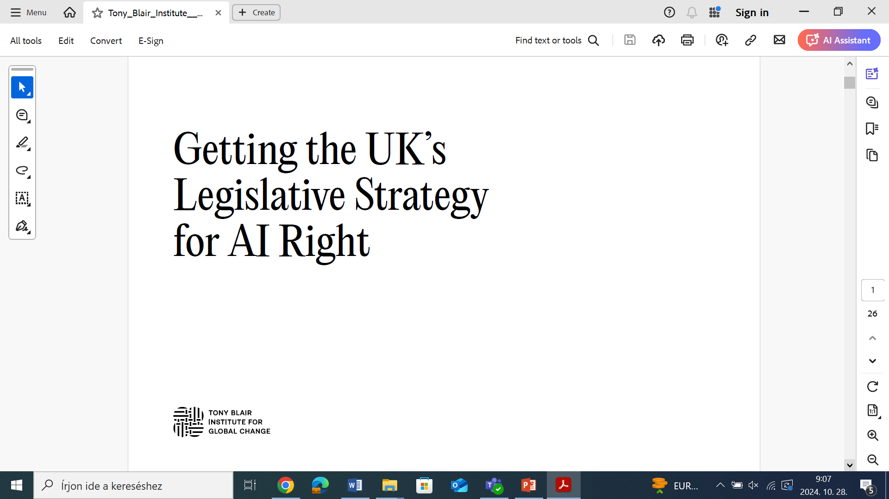

Slide 4
The UK (N.B. by previous government)
principles-based,
5 cross-sectoral principles
non-statutory,
balance innovation and safety by applying the existing technology-neutral regulatory framework (layered regulation/regulatory patchwork);
legislation will be necessary eventually, especially regarding General Purpose AI systems (GPAI)
cross-sector framework (a holistic governance approach)
existing regulators, such as the Information Commissioner's Office (ICO), Ofcom, to implement the five principles as they regulate and supervise AI within their respective domains
they are expected to use a proportionate context-based approach, utilising existing laws and regulations.
implementation
leveraging existing regulatory authorities and frameworks (see cross-sectoral and regulatory patchwork)
establishing a central function to facilitate effective risk monitoring and regulatory coordination (the Central Function within DSIT to monitor and evaluate AI risks, promote coherence and address regulatory gaps
supporting innovation by piloting a multi-agency advisory service - the AI and Digital Hub (pilot multi-regulator advisory service)

Slide 5
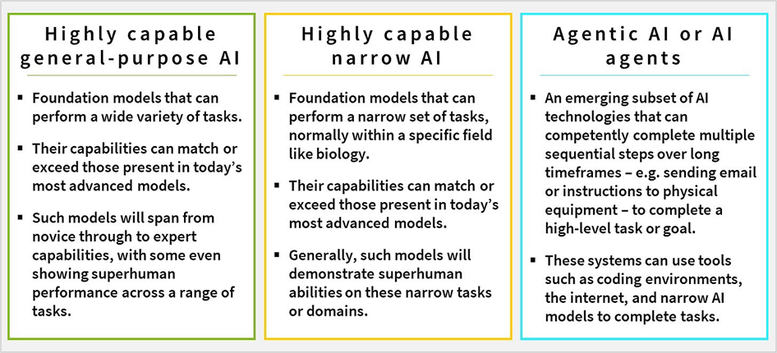
The UK on GPAI
GPAI legislation (prospective)
targeted regulatory interventions aimed at a select group of developers of the most powerful GPAI models and systems to cover transparency, data quality, risk management, accountability, corporate governance, and address harms from misuse or unfair bias
The White Paper on GPAI
lack of understanding (how they work, risks and capabilities)
therefore, wait to figure out how they interact with AI regulatory framework
also, future-proof UK regulation, which is expected to be global standard
however, concrete points:
difference between open-source and closely controlled
opacity and accountability must be closely monitored
developers are few and can be easily monitored, but deployers are more numerous which raises capacity problems
AI (Regulation) Bill [HL] – nothing on GPAI

Slide 6
The US (N.B. Biden administration)
No attempt of regulation or failed attempts at federal level
Executive Order 14110 (on Safe, Secure, and Trustworthy Artificial Intelligence)
nothing specific (a holistic approach):
new standards for AI safety and security
data privacy protection
advancing equity and civil rights
ensuring responsible and effective government use of AI
Blueprint for an AI Bill of Rights
nothing specific

Slide 7
The EU
The AI Act
Prescriptive, but still a patchwork
Specifically addresses GPAI
corresponds with general risk-based approach addressing either use cases or imposing governance/compliance obligations
gives legislative definition of GPAI models and GPAI systems
separate regulatory treatment from AI systems
GPAI models (closed- v. free and open-sourced (non-systemic risk)
transparency requirements: technical documentation + availability of documentation and information to downstream providers
copyright protection system
information on content used to train
representative in the EU
GPAI models that pose systemic risks (with high-impact capabilities)
notify Commission
additional requirement of constant risk assessment and mitigation, and cybersecurity protection system

Slide 8
The EU
What’s missing (from EU, UK, USA etc)?
focus on risks that may come from protection of values and ensuring trust
focus on market and marketing
where is the public law protection/the public law safeguards against the so-called artificial state?
democratic deliberation replaced by prediction by calculation (in politics and policy-making)
equality and equity undermined by prediction
the public sphere reduced to data-driven commerce
what happens with citizenship?
public discourse controlled by private corporations and their automated systems
public-interested digital infrastructure as a public utility?

