Slide 1











Using Semantic Visual Clustering with LLMs to Detect Coordinated Manipulative Narratives in Online Gambling Networks
Massimo Terenzi
Postdoctoral researcher
University of Urbino Carlo Bo
massimo.terenzi@uniurb.it

Slide 2
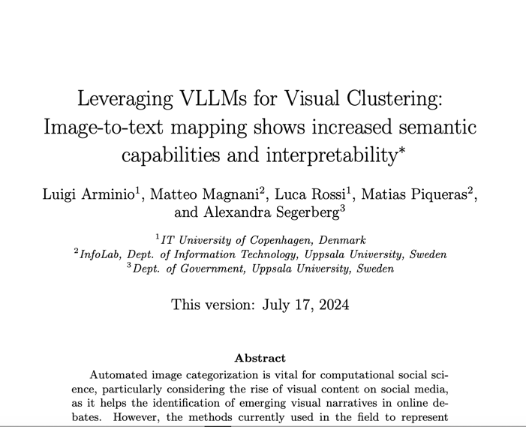
Semantic visual clustering
(Arminio et al. 2024)
Arminio, L., Magnani, M., Piqueras, M., Rossi, L., & Segerberg, A. (2024, July 22). Leveraging VLLMs for Visual Clustering: Image-to-text mapping shows increased semantic capabilities and interpretability. https://doi.org/10.31235/osf.io/bf459

Slide 3
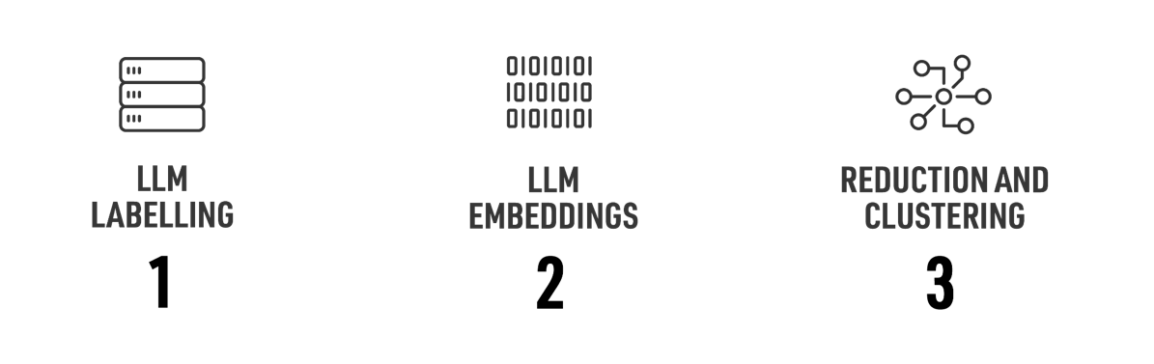
Semantic visual clustering
(Arminio et al. 2024)

Slide 4
Coordinated inauthentic behaviour and problematic information
Coordinated Inauthentic Behavior (CIB) as deliberate actions by groups of pages or accounts aimed at deceiving people about who they are or what they are doing. Unlike fake news, CIB emphasizes the intent and methods of content distribution rather than the accuracy of the information (Gleicher, 2018)
CIB poses significant concerns for the quality of online information; by orchestrating the sharing of content from partisan and insular sources, networks of users can amplify polarizing or manipulative narratives, thereby shaping public perception and contributing to the spread of disinformation within the digital ecosystem (Giglietto et al. 2019)

Slide 5
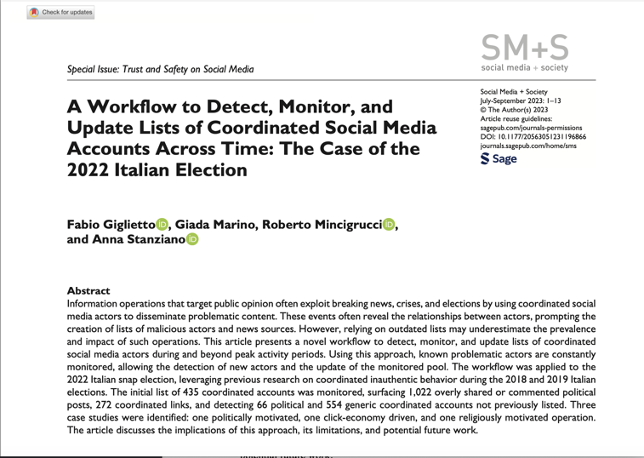
Background and data origins
Giglietto, F., Marino, G., Mincigrucci, R., & Stanziano, A. (2023). A Workflow to Detect, Monitor, and Update Lists of Coordinated Social Media Accounts Across Time: The Case of the 2022 Italian Election. Social Media + Society, 9(3). https://doi.org/10.1177/20563051231196866

Slide 6
Background and data origins
Compilation of preliminary list
Continuous monitoring
Analysis of overperforming posts
Detection of coordination patterns
Updating monitoring list
Adaptive monitoring
Giglietto, F., Righetti, N., & Rossi, L. (2020). CooRnet: Detect coordinated link-sharing behavior on social media. Retrieved from http://coornet.org
Righetti N., Balluff P. (2023). CooRTweet: Coordinated Networks Detection on Social Media. R package version 2.1.0. https://CRAN.R-project.org/package=CooRTweet

Slide 7
Background and data origins
N. coordinated entities | 223 Facebook groups
N. of Facebook posts | 10,671 posts
Time Frame | January 13, 2017 - September 7, 2024
Processing | bulk images download¹
¹ using a script for automated bulk download, available at: https://massimoterenzi.com/mcl-media-downloader/

Slide 8
Methods and research question
  RQ: How effective is semantic visual clustering in identifying and understanding coordinated multimedia strategies that leverage the attention economy to influence user engagement in potentially harmful ways?

Slide 9
Data and methods: AI labelling
Model used:
OpenAIgpt-4o
Prompt
Response
example
Describe the connotative meaning of this image in one paragraph
This image conveys a sense of excitement and opportunity, typical of online gaming platforms designed to entice new users with substantial bonuses and engaging graphics. The bright colors and animated imagery aim to capture attention, while the prominent display of bonuses for first-time deposits emphasizes a rewarding experience. The variety of game categories and titles showcased, such as slots and bingo, suggests a diverse and potentially lucrative gaming environment. The overall connotation is one of thrill, potential wealth, and immediate benefits, encouraging users to engage and spend money in hopes of winning big.

Slide 10
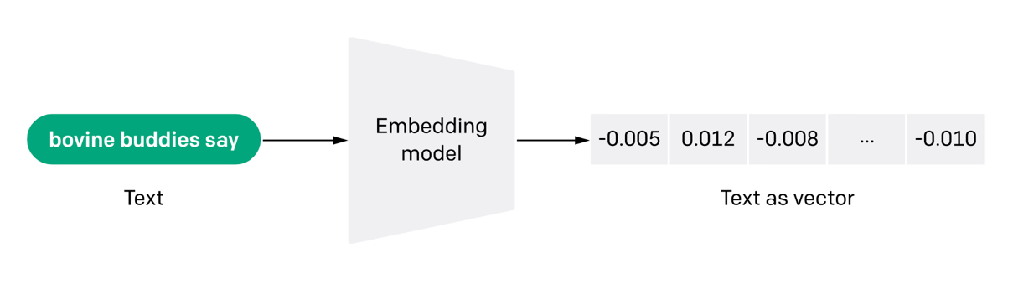
Data and methods: AI embeddings
Model used:
OpenAI text-embedding-3-large

Slide 11
Data and methods: data reduction and clustering
Applied PCA to reduce the dimensionality, retaining 50 principal components that preserved 85% of the original variance.
Utilized UMAP for 2D visualization, balancing local and global relationships; selected optimal parameters: n_neighbors = 30 and min_dist = 0.1.
Employed HDBSCAN to identify density-based clusters, effectively managing noise and outliers.
Tested multiple min_cluster_size values, finding that 50 provided optimal clustering, resulting in 11 distinct clusters.

Slide 12
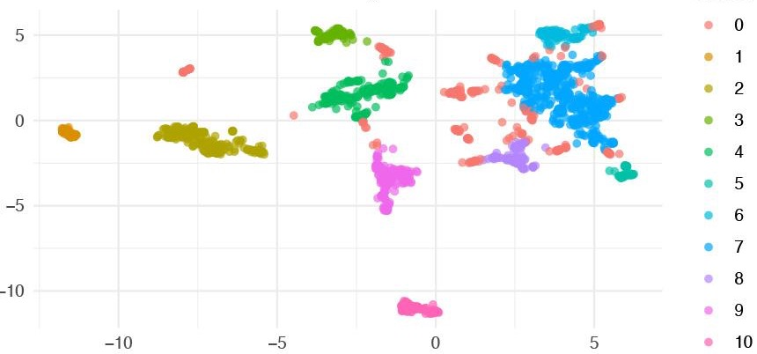
Data and methods: data reduction and clustering
30 nearest neighbors; minimum density = 0.1

Slide 13
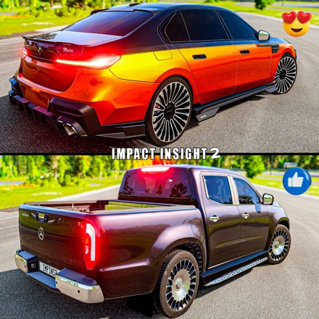
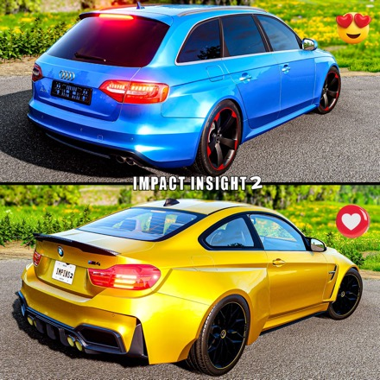
Cluster analysis: {c.1} luxurious lifestyle
Examples from cluster 1

Slide 14
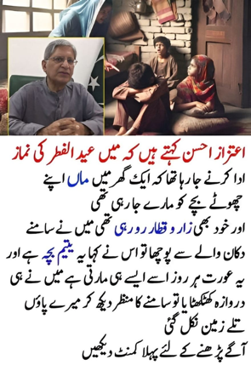
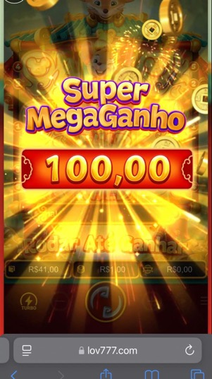
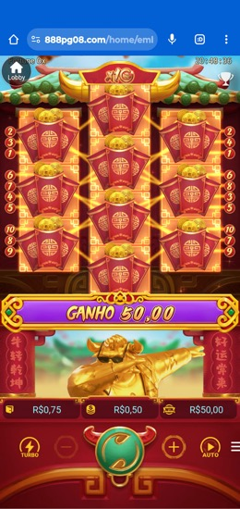
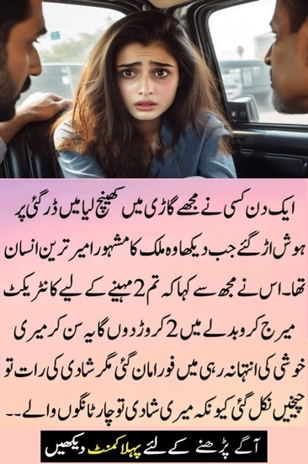
Cluster analysis: {c.2;c.3} linguistic groups
Examples from clusters 2, 3

Slide 15
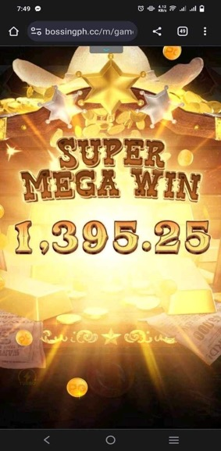
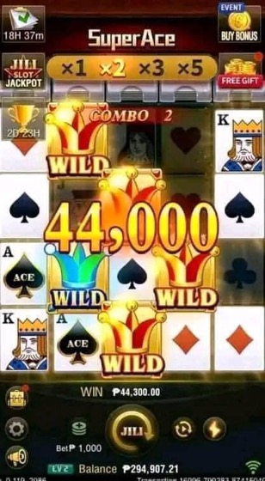
Cluster analysis: {c.4} appealing rewards
Examples from cluster 4

Slide 16


Cluster analysis: {c.5} public figures
Examples from cluster 5

Slide 17
Findings
Revealed underlying visual strategies
The clustering method uncovered distinct visual strategies used in online gambling networks, highlighting how images are designed to manipulate attention and engagement through connotative and persuasive cues.
Captured cultural and emotional nuances
The approach effectively identified cultural targeting, grouping images based on linguistic and cultural elements (e.g., Urdu and Portuguese text) and the use of symbols that evoke themes of prosperity and trust.
Highlighted the effectiveness of automated analysis
The semantic clustering approach proved to be a scalable and efficient solution for analyzing large datasets, enabling deeper insights into manipulative visual content compared to traditional manual analyses.

Slide 18
Limitations and future developments
Inability to analyze video content due to technical limitations
    segment videos into frames for integration into the clustering framework.
  Difficulty in associating clustered images with their original multi-image posts
    Develop advanced tools to handle multi-image associations for accurate engagement analysis.
  High computational cost due to redundant prompt engineering
    Refine prompts to improve efficiency while maintaining analytical accuracy.
  Current methodology does not support multimodal analysis combining text, images, and video
    Integrate multimodal approaches to provide a more comprehensive understanding of manipulative narratives.

Slide 19
Thanks for your attention!
Interested to know more about this work?
Let’s keep in touch!
massimo.terenzi@uniurb.it
mine.uniurb.it
👋

